Slide 1
Responsible Data Science Lecture 20 and 21 Instruction
Introduction to Data Science (IDS) course
IDS-L20-L21

Slide 2


Discrimination
Consider the following potentially discriminatory and the base rules, with the mentioned confidence values.
What range for $α$ causes these rules to be discriminatory?
Base Rule
$$B⇒C$$
Confidence: 0.25
PD Rule
$$A,B⇒C$$
Confidence: 0.55

Slide 3


Discrimination
Consider the following potentially discriminatory and the base rules, with the mentioned confidence values.
What range for $α$ causes these rules to be discriminatory?
Base Rule
$$B⇒C$$
Confidence: 0.25
PD Rule
$$A,B⇒C$$
Confidence: 0.55
$$elift=\frac{confidence(A,B⇒C)}{confidence(B⇒C)}$$
$$elift=\frac{0.55}{0.25}=2.2$$
If $α ≤ 2.2$, then the rule is discriminatory.

Slide 4




Discrimination (Your Turn)
Consider the following potentially discriminatory and the base rules, with the mentioned support values.
What range for $α$ causes these rules to be discriminatory?
Base Rule
$$B⇒C$$
$Support(\{B,C\}):3$0
$$Support(\{B\}):100$$
PD Rule
$$A,B⇒C$$
$$Support(\{A,B,C\}):20$$
$$Support(\{A,B\}):40$$

Slide 5
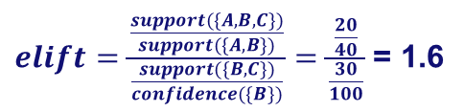

Discrimination (Solution)
Consider the following potentially discriminatory and the base rules, with the mentioned support values.
What range for $α$ causes these rules to be discriminatory?
Base Rule
$$B⇒C$$
$Support(\{B,C\}):3$0
$$Support(\{B\}):100$$
PD Rule
$$A,B⇒C$$
$$Support(\{A,B,C\}):20$$
$$Support(\{A,B\}):40$$
$elift=\frac{\frac{support(\{A,B,C\})}{support(\{A,B\})}}{\frac{support(\{B,C\})}{confidence(\{B\})}}=\frac{\frac{20}{40}}{\frac{30}{100}}$ = 1.6
$$elift=\frac{confidence(A,B⇒C)}{confidence(B⇒C)}$$
If $α ≤1.6$, then the rule is discriminatory.

Slide 6









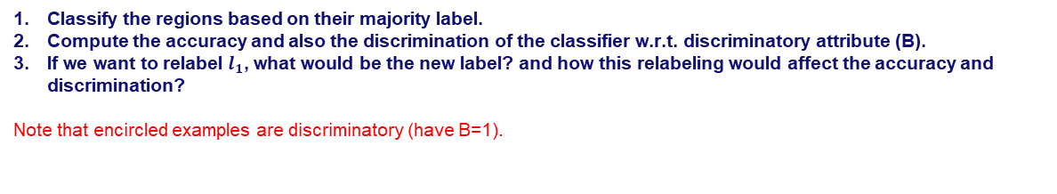


















Discrimination
$$\frac{1}{2}$$
$$A_{1}$$
$$A_{1}$$
$$<\frac{1}{2}$$
$$≥\frac{1}{2}$$
+
$$l_{3}$$
$$l_{4}$$
-
+
-
+
-
+
$$A_{2}$$
$$A_{2}$$
-
-
-
-
$$<\frac{1}{2}$$
$$≥\frac{1}{2}$$
$$<\frac{1}{4}$$
$$≥\frac{3}{4}$$
$$\frac{1}{2}$$
$$l_{1}$$
$$≥\frac{1}{4}$$
-
$$<\frac{3}{4}$$
-
$$l_{5}$$
-
$$l_{2}$$
$$A_{1}$$
+
+
$$l_{1}$$
+
+
$$l_{5}$$
$$l_{6}$$
-
-
$$<\frac{3}{4}$$
$$≥\frac{3}{4}$$
+
+
+
+
$$l_{2}$$
$$l_{6}$$
-
$$l_{3}$$
+
$$l_{4}$$
$$A_{2}$$
Classify the regions based on their majority label.
Compute the accuracy and also the discrimination of the classifier w.r.t. discriminatory attribute (B).
If we want to relabel $l_{1}$, what would be the new label? and how this relabeling would affect the accuracy and discrimination?
Note that encircled examples are discriminatory (have B=1).

Slide 7

















Discrimination
1. Classify the regions based on their majority label.
$$\frac{1}{2}$$
$$A_{1}$$
$$A_{1}$$
$$<\frac{1}{2}$$
$$≥\frac{1}{2}$$
+
$$l_{3}$$
$$l_{4}$$
-
+
-
+
-
+
$$A_{2}$$
$$A_{2}$$
-
-
-
-
$$<\frac{1}{2}$$
$$≥\frac{1}{2}$$
$$<\frac{1}{4}$$
$$≥\frac{3}{4}$$
$$\frac{1}{2}$$
$$l_{1}$$
$$≥\frac{1}{4}$$
-
$$<\frac{3}{4}$$
-
$$l_{5}$$
-
$$l_{2}$$
$$A_{1}$$
+
+
$$l_{1}$$
+
+
$$l_{5}$$
$$l_{6}$$
-
-
$$<\frac{3}{4}$$
$$≥\frac{3}{4}$$
+
+
+
+
$$l_{2}$$
$$l_{6}$$
-
$$l_{3}$$
+
$$l_{4}$$
$$A_{2}$$

Slide 8


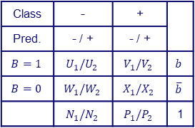

Discrimination
2. Compute the accuracy and also the discrimination of the classifier w.r.t. discriminatory attribute (B).
$$\frac{1}{2}$$
$$A_{1}$$
$$A_{1}$$
$$<\frac{1}{2}$$
$$≥\frac{1}{2}$$
+
$$l_{3}$$
$$l_{4}$$
-
+
-
+
-
+
$$A_{2}$$
$$A_{2}$$
-
-
-
-
$$<\frac{1}{2}$$
$$≥\frac{1}{2}$$
$$<\frac{1}{4}$$
$$≥\frac{3}{4}$$
$$\frac{1}{2}$$
$$l_{1}$$
$$≥\frac{1}{4}$$
-
$$<\frac{3}{4}$$
-
$$l_{5}$$
-
$$l_{2}$$
$$A_{1}$$
+
+
$$l_{1}$$
+
+
$$l_{5}$$
$$l_{6}$$
-
-
$$<\frac{3}{4}$$
$$≥\frac{3}{4}$$
+
+
+
+
$$l_{2}$$
$$l_{6}$$
-
$$l_{3}$$
+
$$l_{4}$$
$$A_{2}$$
Class | - | +
Pred. | - / + | - / +
$$B=1$$ | $$U_{1}/U_{2}$$ | $$V_{1}/V_{2}$$ | $$b$$
$$B=0$$ | $$W_{1}/W_{2}$$ | $$X_{1}/X_{2}$$ | $$\overline{b}$$
 | $$N_{1}/N_{2}$$ | $$P_{1}/P_{2}$$ | 1
Class | - | +
Pred. | - / + | - / +
$$B=1$$ | $$\frac{5}{20}/\frac{1}{20}$$ | $$\frac{1}{20}/\frac{3}{20}$$ | $$\frac{10}{20}$$
$$B=0$$ | $$\frac{3}{20}/\frac{1}{20}$$ | $$\frac{1}{20}/\frac{5}{20}$$ | $$\frac{10}{20}$$
 | $$\frac{8}{20}/\frac{2}{20}$$ | $$\frac{2}{20}/\frac{8}{20}$$ | 1
$${acc}_{T}=N_{1}+P_{2}=\frac{8}{20}+\frac{8}{20}=0.8$$
$${disc}_{T}=\frac{W_{2}+X_{2}}{\overline{b}}−\frac{U_{2}+V_{2}}{b}=\frac{\frac{1}{20}+\frac{5}{20}}{\frac{1}{2}}−\frac{\frac{1}{20}+\frac{3}{20}}{\frac{1}{2}}=0.2$$

Slide 9

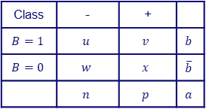
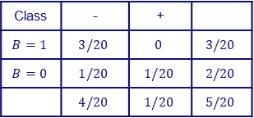

Discrimination
3. If we want to relabel $l_{1}$, what would be the new label? and how this relabeling would affect the accuracy and discrimination?
$$\frac{1}{2}$$
$$A_{1}$$
$$A_{1}$$
$$<\frac{1}{2}$$
$$≥\frac{1}{2}$$
+
$$l_{3}$$
$$l_{4}$$
-
+
-
+
-
+
$$A_{2}$$
$$A_{2}$$
-
-
-
-
$$<\frac{1}{2}$$
$$≥\frac{1}{2}$$
$$<\frac{1}{4}$$
$$≥\frac{3}{4}$$
$$\frac{1}{2}$$
$$l_{1}$$
$$≥\frac{1}{4}$$
-
$$<\frac{3}{4}$$
-
$$l_{5}$$
-
$$l_{2}$$
$$A_{1}$$
+
+
$$l_{1}$$
+
+
$$l_{5}$$
$$l_{6}$$
-
-
$$<\frac{3}{4}$$
$$≥\frac{3}{4}$$
+
+
+
+
$$l_{2}$$
$$l_{6}$$
-
$$l_{3}$$
+
$$l_{4}$$
$$A_{2}$$
Class | - | +
$$B=1$$ | $$u$$ | $$v$$ | $$b$$
$$B=0$$ | $$w$$ | $$x$$ | $$\overline{b}$$
 | $$n$$ | $$p$$ | $$a$$
Class | - | +
$$B=1$$ | $$3/20$$ | $$0$$ | $$3/20$$
$$B=0$$ | $$1/20$$ | $$1/20$$ | $$2/20$$
 | $$4/20$$ | $$1/20$$ | $$5/20$$
$${Δacc}_{l}=p−n=−3/20$$
$${Δdisc}_{l}=−\frac{u+v}{b}+\frac{w+x}{\overline{b}}=−\frac{\frac{3}{20}}{\frac{1}{2}}+\frac{\frac{2}{20}}{\frac{1}{2}}=−0.1$$
$$n>p$$
New label would be +

Slide 10






Discrimination
If we want to relabel $l_{6}$, what would be the new label? and how this relabeling would affect the accuracy and discrimination?
$$\frac{1}{2}$$
$$A_{1}$$
$$A_{1}$$
$$<\frac{1}{2}$$
$$≥\frac{1}{2}$$
+
$$l_{3}$$
$$l_{4}$$
-
+
-
+
-
+
$$A_{2}$$
$$A_{2}$$
-
-
-
-
$$<\frac{1}{2}$$
$$≥\frac{1}{2}$$
$$<\frac{1}{4}$$
$$≥\frac{3}{4}$$
$$\frac{1}{2}$$
$$l_{1}$$
$$≥\frac{1}{4}$$
-
$$<\frac{3}{4}$$
-
$$l_{5}$$
-
$$l_{2}$$
$$A_{1}$$
+
+
$$l_{1}$$
+
+
$$l_{5}$$
$$l_{6}$$
-
-
$$<\frac{3}{4}$$
$$≥\frac{3}{4}$$
+
+
+
+
$$l_{2}$$
$$l_{6}$$
-
$$l_{3}$$
+
$$l_{4}$$
$$A_{2}$$

Slide 11

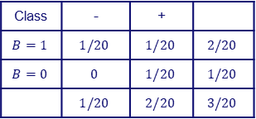

Discrimination
If we want to relabel $l_{6}$, what would be the new label? and how this relabeling would affect the accuracy and discrimination?
$$\frac{1}{2}$$
$$A_{1}$$
$$A_{1}$$
$$<\frac{1}{2}$$
$$≥\frac{1}{2}$$
+
$$l_{3}$$
$$l_{4}$$
-
+
-
+
-
+
$$A_{2}$$
$$A_{2}$$
-
-
-
-
$$<\frac{1}{2}$$
$$≥\frac{1}{2}$$
$$<\frac{1}{4}$$
$$≥\frac{3}{4}$$
$$\frac{1}{2}$$
$$l_{1}$$
$$≥\frac{1}{4}$$
-
$$<\frac{3}{4}$$
-
$$l_{5}$$
-
$$l_{2}$$
$$A_{1}$$
+
+
$$l_{1}$$
+
+
$$l_{5}$$
$$l_{6}$$
-
-
$$<\frac{3}{4}$$
$$≥\frac{3}{4}$$
+
+
+
+
$$l_{2}$$
$$l_{6}$$
-
$$l_{3}$$
+
$$l_{4}$$
$$A_{2}$$
Class | - | +
$$B=1$$ | $$u$$ | $$v$$ | $$b$$
$$B=0$$ | $$w$$ | $$x$$ | $$\overline{b}$$
 | $$n$$ | $$p$$ | $$a$$
Class | - | +
$$B=1$$ | $$1/20$$ | $$1/20$$ | $$2/20$$
$$B=0$$ | $$0$$ | $$1/20$$ | $$1/20$$
 | $$1/20$$ | $$2/20$$ | $$3/20$$
$${Δacc}_{l}=n−p=−1/20$$
$${Δdisc}_{l}=\frac{u+v}{b}−\frac{w+x}{\overline{b}}=\frac{\frac{2}{20}}{\frac{1}{2}}−\frac{\frac{1}{20}}{\frac{1}{2}}=0.1$$
$$n<p$$
New label would be -

Slide 12
Discrimination (Your Turn)
If we want to relabel $l_{4}$, what would be the new label? and how this relabeling would affect the accuracy and discrimination?
$$\frac{1}{2}$$
$$A_{1}$$
$$A_{1}$$
$$<\frac{1}{2}$$
$$≥\frac{1}{2}$$
+
$$l_{3}$$
$$l_{4}$$
-
+
-
+
-
+
$$A_{2}$$
$$A_{2}$$
-
-
-
-
$$<\frac{1}{2}$$
$$≥\frac{1}{2}$$
$$<\frac{1}{4}$$
$$≥\frac{3}{4}$$
$$\frac{1}{2}$$
$$l_{1}$$
$$≥\frac{1}{4}$$
-
$$<\frac{3}{4}$$
-
$$l_{5}$$
-
$$l_{2}$$
$$A_{1}$$
+
+
$$l_{1}$$
+
+
$$l_{5}$$
$$l_{6}$$
-
-
$$<\frac{3}{4}$$
$$≥\frac{3}{4}$$
+
+
+
+
$$l_{2}$$
$$l_{6}$$
-
$$l_{3}$$
+
$$l_{4}$$
$$A_{2}$$

Slide 13
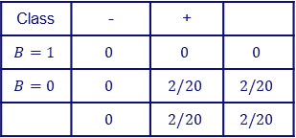

Discrimination (Solution)
If we want to relabel $l_{4}$, what would be the new label? and how this relabeling would affect the accuracy and discrimination?
$$\frac{1}{2}$$
$$A_{1}$$
$$A_{1}$$
$$<\frac{1}{2}$$
$$≥\frac{1}{2}$$
+
$$l_{3}$$
$$l_{4}$$
-
+
-
+
-
+
$$A_{2}$$
$$A_{2}$$
-
-
-
-
$$<\frac{1}{2}$$
$$≥\frac{1}{2}$$
$$<\frac{1}{4}$$
$$≥\frac{3}{4}$$
$$\frac{1}{2}$$
$$l_{1}$$
$$≥\frac{1}{4}$$
-
$$<\frac{3}{4}$$
-
$$l_{5}$$
-
$$l_{2}$$
$$A_{1}$$
+
+
$$l_{1}$$
+
+
$$l_{5}$$
$$l_{6}$$
-
-
$$<\frac{3}{4}$$
$$≥\frac{3}{4}$$
+
+
+
+
$$l_{2}$$
$$l_{6}$$
-
$$l_{3}$$
+
$$l_{4}$$
$$A_{2}$$
Class | - | +
$$B=1$$ | $$u$$ | $$v$$ | $$b$$
$$B=0$$ | $$w$$ | $$x$$ | $$\overline{b}$$
 | $$n$$ | $$p$$ | $$a$$
Class | - | +
$$B=1$$ | $$0$$ | $$0$$ | $$0$$
$$B=0$$ | $$0$$ | $$2/20$$ | $$2/20$$
 | $$0$$ | $$2/20$$ | $$2/20$$
$${Δacc}_{l}=n−p=−0.1$$
$${Δdisc}_{l}=\frac{u+v}{b}−\frac{w+x}{\overline{b}}=\frac{0}{\frac{1}{2}}−\frac{\frac{2}{20}}{\frac{1}{2}}=−0.2$$
$$n<p$$
New label would be -

Slide 14
Discrimination (Your Turn)
In the following DT classifier, relabeling which leaf leads to the maximum reduction on the discrimination?
$$\frac{1}{2}$$
$$A_{1}$$
$$A_{1}$$
$$<\frac{1}{2}$$
$$≥\frac{1}{2}$$
-
$$l_{3}$$
$$l_{4}$$
-
-
-
+
-
+
$$A_{2}$$
$$A_{2}$$
-
-
-
-
$$<\frac{1}{2}$$
$$≥\frac{1}{2}$$
$$<\frac{1}{4}$$
$$≥\frac{3}{4}$$
$$\frac{1}{2}$$
$$l_{1}$$
$$≥\frac{1}{4}$$
-
$$<\frac{3}{4}$$
+
$$l_{5}$$
-
$$l_{2}$$
$$A_{1}$$
+
+
$$l_{1}$$
+
+
$$l_{5}$$
$$l_{6}$$
-
$$<\frac{3}{4}$$
+
+
+
$$≥\frac{3}{4}$$
$$l_{2}$$
+
+
$$l_{6}$$
-
$$l_{3}$$
+
$$l_{4}$$
$$A_{2}$$

Slide 15

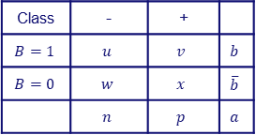
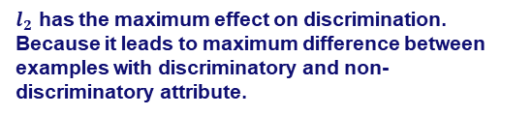

Discrimination (Solution)
In the following DT classifier, relabeling which leaf leads to the maximum reduction on the discrimination?
$$\frac{1}{2}$$
$$A_{1}$$
$$A_{1}$$
$$<\frac{1}{2}$$
$$≥\frac{1}{2}$$
-
$$l_{3}$$
$$l_{4}$$
-
-
-
+
-
+
$$A_{2}$$
$$A_{2}$$
-
-
-
-
$$<\frac{1}{2}$$
$$≥\frac{1}{2}$$
$$<\frac{1}{4}$$
$$≥\frac{3}{4}$$
$$\frac{1}{2}$$
$$l_{1}$$
$$≥\frac{1}{4}$$
-
$$<\frac{3}{4}$$
+
$$l_{5}$$
-
$$l_{2}$$
$$A_{1}$$
+
+
$$l_{1}$$
+
+
$$l_{5}$$
$$l_{6}$$
-
$$<\frac{3}{4}$$
+
+
+
$$≥\frac{3}{4}$$
$$l_{2}$$
+
+
$$l_{6}$$
-
$$l_{3}$$
+
$$l_{4}$$
$$A_{2}$$
Class | - | +
$$B=1$$ | $$u$$ | $$v$$ | $$b$$
$$B=0$$ | $$w$$ | $$x$$ | $$\overline{b}$$
 | $$n$$ | $$p$$ | $$a$$
$${Δdisc}_{l}=−\frac{u+v}{b}+\frac{w+x}{\overline{b}}$$
1. The first step is to find the leaf with the maximum effect (positive or negative)
$l_{2}$ has the maximum effect on discrimination. Because it leads to maximum difference between examples with discriminatory and non-discriminatory attribute.
$${Δdisc}_{l}=\frac{u+v}{b}−\frac{w+x}{\overline{b}}$$

Slide 16

Discrimination (Solution)
In the following DT classifier, relabeling which leaf leads to the maximum reduction on the discrimination?
$$\frac{1}{2}$$
$$A_{1}$$
$$A_{1}$$
$$<\frac{1}{2}$$
$$≥\frac{1}{2}$$
-
$$l_{3}$$
$$l_{4}$$
-
-
-
+
-
+
$$A_{2}$$
$$A_{2}$$
-
-
-
-
$$<\frac{1}{2}$$
$$≥\frac{1}{2}$$
$$<\frac{1}{4}$$
$$≥\frac{3}{4}$$
$$\frac{1}{2}$$
$$l_{1}$$
$$≥\frac{1}{4}$$
-
$$<\frac{3}{4}$$
+
$$l_{5}$$
-
$$l_{2}$$
$$A_{1}$$
+
+
$$l_{1}$$
+
+
$$l_{5}$$
$$l_{6}$$
-
$$<\frac{3}{4}$$
+
+
+
$$≥\frac{3}{4}$$
$$l_{2}$$
+
+
$$l_{6}$$
-
$$l_{3}$$
+
$$l_{4}$$
$$A_{2}$$
2. The aim is to either decrease the first part or increase the second part in the discrimination formula.
Probability of getting a positive label for an instance with B = 0
Relabeling $l_{2}$ leads to maximum reduction (0.5) of the first part and consequently causes maximum reduction of discrimination.
$${disc}_{T}=\frac{W_{2}+X_{2}}{\overline{b}}−\frac{U_{2}+V_{2}}{b}$$
Probability of getting a positive label for an instance with B = 1

Slide 17
Discrimination (Your Turn)
In the following DT classifier, relabeling which leaf has the maximum effect on the accuracy?
$$\frac{1}{2}$$
$$A_{1}$$
$$A_{1}$$
$$<\frac{1}{2}$$
$$≥\frac{1}{2}$$
+
$$l_{3}$$
$$l_{4}$$
-
-
+
+
-
+
-
-
$$A_{2}$$
$$A_{2}$$
-
-
$$<\frac{1}{4}$$
$$≥\frac{3}{4}$$
$$l_{1}$$
+
$$<\frac{1}{2}$$
$$≥\frac{1}{2}$$
$$\frac{1}{2}$$
$$≥\frac{1}{4}$$
-
$$<\frac{3}{4}$$
-
$$l_{5}$$
-
$$l_{2}$$
$$A_{1}$$
-
$$l_{1}$$
+
+
$$l_{5}$$
$$l_{6}$$
-
$$<\frac{3}{4}$$
+
+
-
$$≥\frac{3}{4}$$
$$l_{2}$$
+
+
$$l_{6}$$
-
$$l_{3}$$
+
$$l_{4}$$
$$A_{2}$$

Slide 18
Discrimination (Solution)
In the following DT classifier, relabeling which leaf has the maximum effect on the accuracy?
$$\frac{1}{2}$$
$$A_{1}$$
$$A_{1}$$
$$<\frac{1}{2}$$
$$≥\frac{1}{2}$$
+
$$l_{3}$$
$$l_{4}$$
-
-
+
+
-
+
-
-
$$A_{2}$$
$$A_{2}$$
-
-
$$<\frac{1}{4}$$
$$≥\frac{3}{4}$$
$$l_{1}$$
+
$$<\frac{1}{2}$$
$$≥\frac{1}{2}$$
$$\frac{1}{2}$$
$$≥\frac{1}{4}$$
-
$$<\frac{3}{4}$$
-
$$l_{5}$$
-
$$l_{2}$$
$$A_{1}$$
-
$$l_{1}$$
+
+
$$l_{5}$$
$$l_{6}$$
-
$$<\frac{3}{4}$$
+
+
-
$$≥\frac{3}{4}$$
$$l_{2}$$
+
+
$$l_{6}$$
-
$$l_{3}$$
+
$$l_{4}$$
$$A_{2}$$
Of course $l_{1}$ contains the examples which lead to maximum difference between labels ($\frac{1}{20}−\frac{5}{20}=−\frac{4}{20}$). Therefore, relabeling this leaf has the maximum effect on the accuracy.

Slide 19









Discrimination (Homework)
In the following DT classifier, relabeling which leaf leads to the maximum reduction of the discrimination, and minimum reduction of the accuracy (the best leaf for relabeling)?
$$\frac{1}{2}$$
$$A_{1}$$
$$A_{1}$$
$$<\frac{1}{2}$$
$$≥\frac{1}{2}$$
-
$$l_{3}$$
$$l_{4}$$
-
-
-
+
-
+
$$A_{2}$$
$$A_{2}$$
-
-
-
-
$$<\frac{1}{2}$$
$$≥\frac{1}{2}$$
$$<\frac{1}{4}$$
$$≥\frac{3}{4}$$
$$\frac{1}{2}$$
$$l_{1}$$
$$≥\frac{1}{4}$$
-
$$<\frac{3}{4}$$
-
$$l_{5}$$
-
$$l_{2}$$
$$A_{1}$$
+
+
$$l_{1}$$
+
+
$$l_{5}$$
$$l_{6}$$
-
$$<\frac{3}{4}$$
+
+
+
$$≥\frac{3}{4}$$
$$l_{2}$$
+
+
$$l_{6}$$
-
$$l_{3}$$
+
$$l_{4}$$
$$A_{2}$$

Slide 20
Discrimination (Homework)
What is the first node of the decision tree for the following table of data with respect to accuracy and fairness? (use $IGC−IGS$)
Sex | Exp | Degree | Job | Class
F | Exp >10 | HS | Board | -
M | 5< Exp <10 | Uni | Board | +
M | Exp >10 | HS | Board | -
M | 5< Exp <10 | HS | Hcare | +
M | Exp < 5 | HS | Hcare | +
F | Exp < 5 | HS | Board | -
M | Exp < 5 | None | Edu | -
F | Exp >10 | None | Hcare | -
M | Exp < 5 | Uni | Edu | +
M | Exp >10 | Uni | Board | +

Slide 21
Confidentiality
Suppose that we have such a following tables of information about people and what they bought from an online grocery shop.
Name | Age | Gender | State of domicile | Religion | Product
Ramsha | 22 | Female | Tamil Nadu | Hindu | Pea
Yadu | 24 | Female | Kerala | Hindu | Bean
Salima | 25 | Female | Tamil Nadu | Muslim | Peanut
Sunny | 25 | Male | Karnataka | Buddhist | Pea
Joan | 24 | Female | Kerala | Muslim | Bean
Bahuksana | 23 | Male | Karnataka | Buddhist | Lentil
Rambha | 19 | Male | Kerala | Christian | Peanut
Kishor | 24 | Male | Karnataka | Buddhist | Lentil
Johnson | 17 | Male | Kerala | Christian | Peanut
John | 19 | Male | Kerala | Christian | Pea
Specify type of each attribute:
Explicit Identifier
Quasi-identifier
Sensitive
Convert this data to 2-anonymity table.

Slide 22
Confidentiality
Explicit identifier
Quasi-identifiers
Sensitive
Name | Age | Gender | State of domicile | Religion | Product
Ramsha | 22 | Female | Tamil Nadu | Hindu | Pea
Yadu | 24 | Female | Kerala | Hindu | Bean
Salima | 25 | Female | Tamil Nadu | Muslim | Peanut
Sunny | 25 | Male | Karnataka | Buddhist | Pea
Joan | 24 | Female | Kerala | Muslim | Bean
Bahuksana | 23 | Male | Karnataka | Buddhist | Lentil
Rambha | 19 | Male | Kerala | Christian | Peanut
Kishor | 24 | Male | Karnataka | Buddhist | Lentil
Johnson | 17 | Male | Kerala | Christian | Peanut
John | 19 | Male | Kerala | Christian | Pea

Slide 23
Confidentiality
2-anonymity
Data is k-anonymity if each equivalence class contains at least k records.
Equivalence class is a set of records that have the same values for the quasi-identifiers.
2-anonymity, distinct 2-diversity
Data is distinct l-diversity if there are at least l distinct values for the sensitive attribute in each equivalence class.
Name | Age | Gender | State of domicile | Religion | Product
* | 20 < Age ≤ 25 | Female | Tamil Nadu | * | Pea
* | 20 < Age ≤ 25 | Female | Kerala | * | Bean
* | 20 < Age ≤ 25 | Female | Tamil Nadu | * | Peanut
* | 20 < Age ≤ 25 | Male | Karnataka | * | Pea
* | 20 < Age ≤ 25 | Female | Kerala | * | Bean
* | 20 < Age ≤ 25 | Male | Karnataka | * | Lentil
* | Age ≤ 20 | Male | Kerala | * | Peanut
* | 20 < Age ≤ 25 | Male | Karnataka | * | Lentil
* | Age ≤ 20 | Male | Kerala | * | Peanut
* | Age ≤ 20 | Male | Kerala | * | Pea
Name | Age | Gender | State of domicile | Religion | Product
* | 20 < Age ≤ 25 | Female | * | Hindu | Pea
* | 20 < Age ≤ 25 | Female | * | Hindu | Bean
* | 20 < Age ≤ 25 | Female | * | Muslim | Peanut
* | 20 < Age ≤ 25 | Male | * | Buddhist | Pea
* | 20 < Age ≤ 25 | Female | * | Muslim | Bean
* | 20 < Age ≤ 25 | Male | * | Buddhist | Lentil
* | Age ≤ 20 | Male | * | Christian | Peanut
* | 20 < Age ≤ 25 | Male | * | Buddhist | Lentil
* | Age ≤ 20 | Male | * | Christian | Peanut
* | Age ≤ 20 | Male | * | Christian | Pea

Slide 24
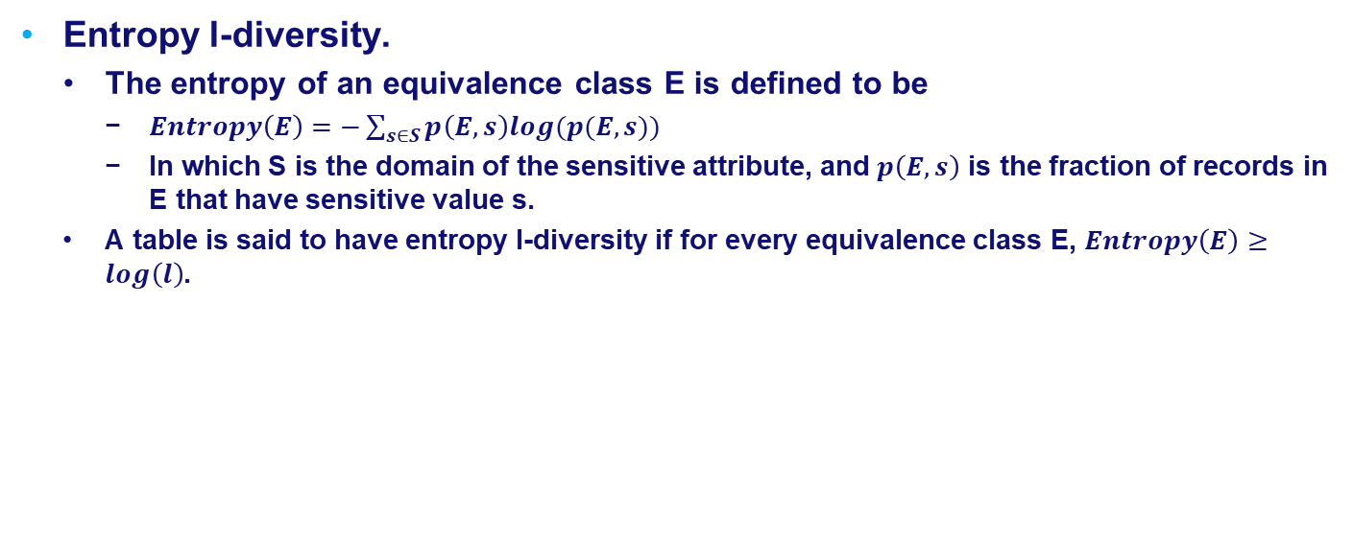
Confidentiality
Entropy l-diversity.
The entropy of an equivalence class E is defined to be
$Entropy\left(E\right)=−\sum_{s∈S}{p\left(E,s\right)log(p(E,s)) }$
In which S is the domain of the sensitive attribute, and $p\left(E,s\right)$ is the fraction of records in E that have sensitive value s.
A table is said to have entropy l-diversity if for every equivalence class E, $Entropy\left(E\right)≥log\left(l\right)$.

Slide 25
Confidentiality (Your Turn)
What is the maximum value for l based on the following table which has 2-anonimity and entropy l-diversity?
Name | Age | Gender | State of domicile | Religion | Product
* | 20 < Age ≤ 25 | Female | * | Hindu | Pea
* | 20 < Age ≤ 25 | Female | * | Hindu | Bean
* | 20 < Age ≤ 25 | Female | * | Muslim | Peanut
* | 20 < Age ≤ 25 | Male | * | Buddhist | Pea
* | 20 < Age ≤ 25 | Female | * | Muslim | Bean
* | 20 < Age ≤ 25 | Male | * | Buddhist | Lentil
* | Age ≤ 20 | Male | * | Christian | Peanut
* | 20 < Age ≤ 25 | Male | * | Buddhist | Lentil
* | Age ≤ 20 | Male | * | Christian | Peanut
* | Age ≤ 20 | Male | * | Christian | Pea

Slide 26



Confidentiality (Solution)
What is the maximum value for l to have based on the following table which has entropy l-diversity?
Name | Age | Gender | State of domicile | Religion | Product
* | 20 < Age ≤ 25 | Female | * | Hindu | Pea
* | 20 < Age ≤ 25 | Female | * | Hindu | Bean
* | 20 < Age ≤ 25 | Female | * | Muslim | Peanut
* | 20 < Age ≤ 25 | Male | * | Buddhist | Pea
* | 20 < Age ≤ 25 | Female | * | Muslim | Bean
* | 20 < Age ≤ 25 | Male | * | Buddhist | Lentil
* | Age ≤ 20 | Male | * | Christian | Peanut
* | 20 < Age ≤ 25 | Male | * | Buddhist | Lentil
* | Age ≤ 20 | Male | * | Christian | Peanut
* | Age ≤ 20 | Male | * | Christian | Pea
Entropy = 1
Entropy = 1
Entropy = 0.92
Entropy = 0.92
$$Entropy(E)≥log(l)$$
$$log\left(l\right)=0.92$$
$$l=1.9$$

Slide 27
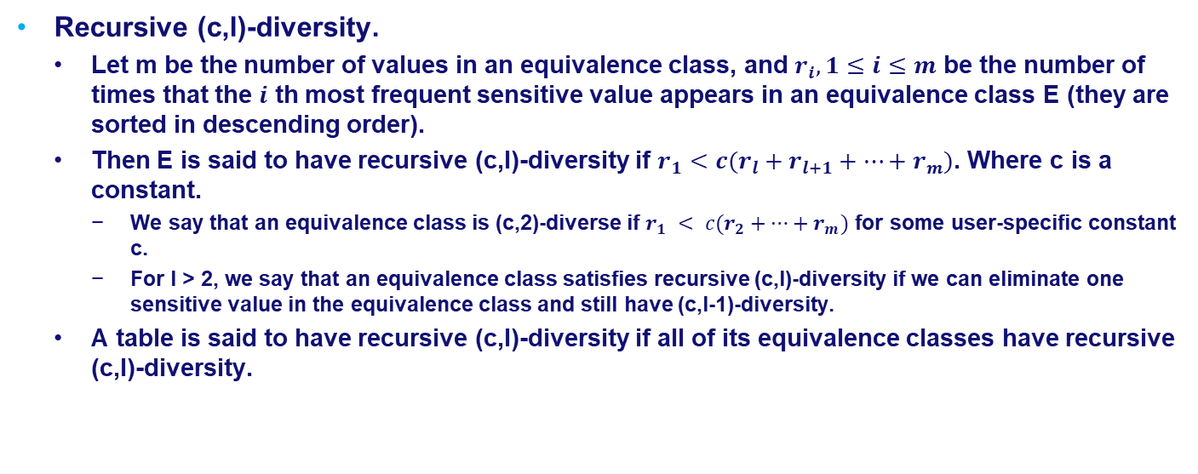
Confidentiality
Recursive (c,l)-diversity.
Let m be the number of values in an equivalence class, and $r_{i}, 1≤i≤m$ be the number of times that the $i$ th most frequent sensitive value appears in an equivalence class E (they are sorted in descending order).
Then E is said to have recursive (c,l)-diversity if $r_{1}<c(r_{l}+r_{l+1}+…+r_{m})$. Where c is a constant.
We say that an equivalence class is (c,2)-diverse if $r_{1} < c(r_{2}+…+r_{m})$ for some user-specific constant c.
For l > 2, we say that an equivalence class satisfies recursive (c,l)-diversity if we can eliminate one sensitive value in the equivalence class and still have (c,l-1)-diversity.
A table is said to have recursive (c,l)-diversity if all of its equivalence classes have recursive (c,l)-diversity.

Slide 28

Confidentiality (Your Turn)
Assume the following list as the list of frequency of sensitive values in an equivalence class.
Does the corresponding equivalence class have recursive (1,2)-diversity?
Does the corresponding equivalence class have recursive (2,3)-diversity?
$Frequency list = (r_{1}=500,r_{2}=400,r_{3}=200,r_{4}=50,r_{5}=20)$

Slide 29







Confidentiality (Solution)
Assume the following list as the list of frequency of sensitive values in an equivalence class.
Does the corresponding equivalence class have recursive (1,2)-diversity?
Does the corresponding equivalence class have recursive (2,3)-diversity?
$Frequency list = (r_{1}=500,r_{2}=400,r_{3}=200,r_{4}=50,r_{5}=20)$
$$r_{1}<c(r_{l}+r_{l+1}+…+r_{m})$$
$$r_{1}<1(r_{2}+r_{3}+r_{4}+r_{5})$$
$$l=2, c=1$$
$$500<1(400+200+50+20)$$
The corresponding equivalence class has recursive (1,2)-diversity
$$r_{1}<2(r_{3}+r_{4}+r_{5})$$
$$l=3, c=2$$
$$500<2(200+50+20)$$
The corresponding equivalence class has recursive (2,3)-diversity

